Slide 1




Hatfield Peverel St Andrew’s Junior School
NEWSLETTER
25th February 2022
Dear Parents and Carers,
What a blustery return to school it has been! Our toy sheds were damaged by Storm Eunice, but apart from this were escaped remarkably well.
This week has seen a few changes at playtimes too. The ‘no coat no play’ rule has been relaxed (thanks to the spring sunshine!)- please ensure that your child still has a coat in school. We have also allowed the children in upper and lower school to play in the same play spaces at lunch and playtime.
We will have our first Whole school Assembly next Thursday- when we celebrate World Book Day.
We are all really looking forward to the World Book Day events next week, Mrs Smith has worked really hard to create ‘stress-free’, creative and literary thought-provoking activities.
Have a lovely weekend! Mrs Black and the St Andrew’s team
A big St. Andrew’s WELCOME to Ava who has joined Fir Base in Year 4 and Jaidyn who has joined Maple Base in Year 5. We are sure that you and your families will quickly settle into St Andrew’s!

Slide 2




Wishing a very Happy Birthday
to those who have celebrated
their birthdays between:
21st and 27th February 2022
Charlotte B,
Mrs Spilling
Vinehurst | 494
Greystones | 435
Priory | 435
Berwicks | 356
These are the children who have been spotted shining in school this week. We could have chosen so many children- the decisions were hard to make!
Well done for demonstrating our CARE values.
Archie – Apple
Emelia – Birch
Jack T – Cherry
Ava – Fir
Amy – Maple
Emily - Oak
Fearne – Rowan
Evan – Sycamore
Compassion Achievement Respect Enjoyment
Every child is loved and known.
Every child shines.

Slide 3
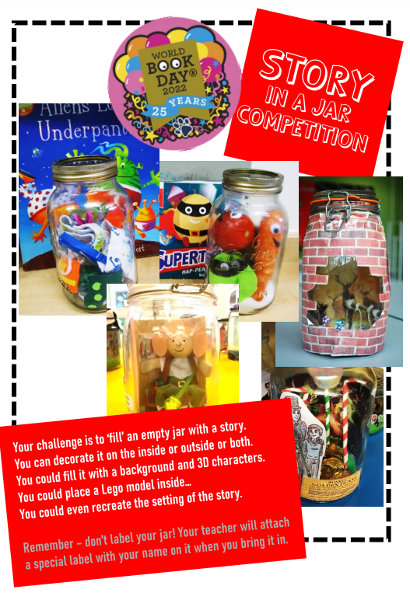

Slide 4


Slide 5


Amazon Wish-Lists
We are asked from time to time by parents how they can help support the children by providing resources or volunteering their time via either the JSA, on trips or with reading etc in the classroom. All are most welcomed and we are enormously grateful to those parents for their help and support. We list below links to our year group Amazon wish-lists (with several new items added) if this should be your preferred way to support the children (but only if you can and would like to):-
Year 3:- https://amzn.eu/bS9YjA9
Year 4:- https://amzn.eu/hIHTvhN
Year 5:- https://amzn.eu/2ETMWXS
Year 6:- https://amzn.eu/bhCBWrK
AmazonSmile is a simple way for you to support your favorite charitable organisation every time you shop, at no cost to you. AmazonSmile is available at smile.amazon.com on your web browser and can be activated in the Amazon Shopping app for iOS and Android phones.
Please select ‘St. Andrew’s Junior School Association’ to sign up and help support the school - via the JSA (a registered Charity) - at no extra cost to you.
More information to follow
If the news is worrying your child, this Newsround link might have some useful strategies to use.
https://www.bbc.co.uk/newsround/13865002?fbclid=IwAR08DEropDZxp89ieShju2GDOxWLtUEy7DuVWURlYOIpEEs8M8fkIvnZRPs

Slide 6

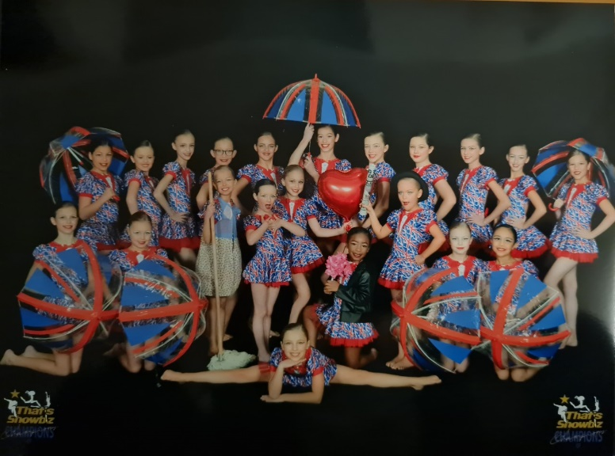
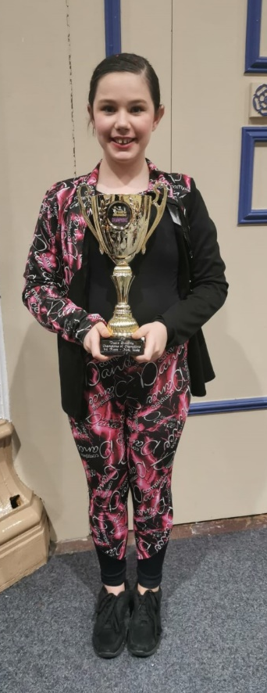

Spotlight on
Shining at home
Phoebe in year six recently attended a ‘Champion of Champtions’ dance competition in Skegness. Her dance group aged 6-11 came 3rd out of 42!
Well done Phoebe!
Well done to Eden in year three. He recently stood in as goal-keeper playing against a Colchester United Academy team. It was a fast-pace and hard match but he made his family very proud. Well done Eden!
If your child has shone at home- please do use the year group email addresses to share
proud moments.

Slide 7
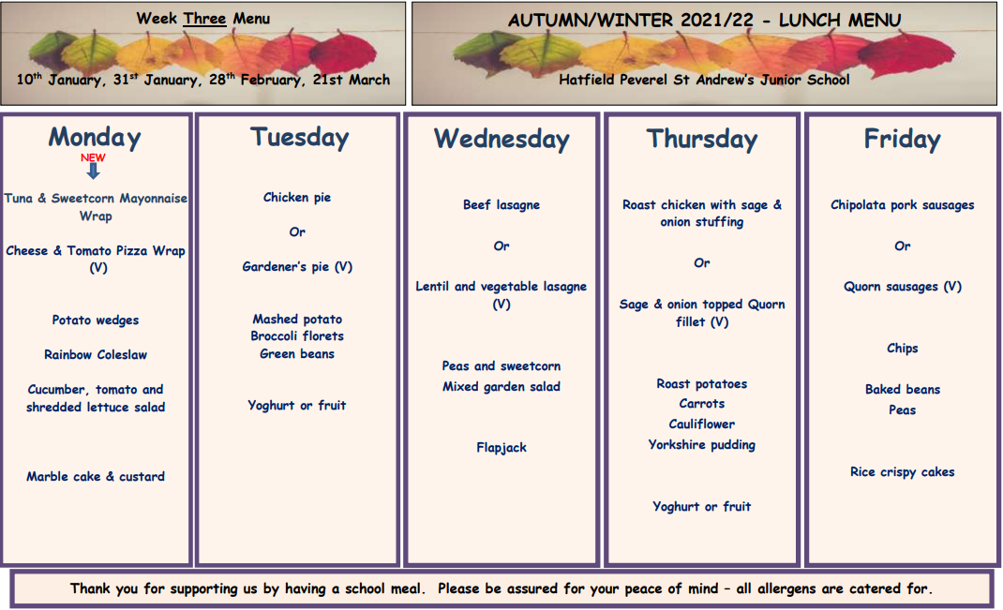

PLEASE NOTE SLIGHT AMENDMENTS TO OUR LUNCH MENUS
Week 3 – week commencing 28th February
Thank you for helping to support our school by choosing a school meal for your child/ren.
Meals are £2.20 daily and can be ordered by your child in class during registration each morning.
Our preferred payment method is via Pay360 Education Payments –
please contact the office if you have yet to register for this.
SHROVE TUESDAY
Dessert - traditional pancakes (served with lemon or chocolate sauce)
Please note a change to the menu next Wednesday – meatballs (or veggie meatballs) & pasta instead of lasagne.
You might be interested in this, for more information or to make a nomination please follow this link
https://www.teachingawards.com/2022awards/?utm_campaign=tat2021&utm_medium=email&utm_source=govdelivery

Slide 8

As per our Parentmail sent earlier in the week…………
We are writing to inform you of some very exciting news for the Infant School; they are currently in discussions with Essex County Council about lowering their admissions age to include nursery age children.
Hatfield Peverel Day Nursery will be relinquishing their lease in August presenting the infant school with this opportunity to become an infant and nursery school from September 2022.
Hatfield Peverel Infant School’s vision is to deliver Nursery provision that dovetails with their already well established Early Years Reception Class, enabling a smooth transition into school life. As part of their school, the nursery children will also benefit from access to all of the resources and external areas, increasing their range of experiences. They are looking forward to developing a relationship with the current nursery staff, sharing expertise and knowledge for a strong foundation and bright future for the children.
As part of this process, the Infant School are running a four-week consultation. In order to ascertain opinion and need within the community they have created a short anonymous Google survey. You will find the link to this survey below and the flyer attached to this email, publicising this.
The Infant School would be grateful if you would take the time to complete this survey and share your views. Thank you.
https://forms.gle/ALuy4J8UFC2xW6rNA

Slide 9


To win this fantastic day out simply answer the 4 questions correctly in our weekly quiz, complete the entry form printed in the paper and send the answer to us here at the Braintree & Witham Times.
All correct entries will then be put into a prize draw. Questions will appear in the paper from Monday 28th February 2022 until Friday 25th March 2022. All entries must be received by the competition closing date, Friday 1st April 2022.
For further details please visit www.gazette-news/promotions

Slide 10


Hello Hatfield Peverel supporters,
We are trying to hold an Open Garden on Saturday 16th July to help raise vital funds for our Charity.
Do you think you can help us by adding your gardens address to our list of ‘open gardens’ on the day?? Or if you are a business in the village and would possibly be interested in supporting the event?
Event outline
People will purchase a map from the Charity of listed ‘open gardens’ and visit all the different varieties of gardens Hatfield Peverel has to offer. There is no cost for adding your garden onto the map – we would just ask you allow people to visit your garden, maybe offer a cup of tea or glass of lemonade from 10 – 2.
To make this event work we really need addresses of a least a good few gardens to offer that will be open to the public (on purchase of a map from us).
We would really appreciate if you think you could possibly add your garden onto this list for the day, who knows you could meet some neighbours you never knew and make a new friend all whilst raising money for the our Charity which is right in the heart of your village. We are also asking for any plant donations that we can sell from our garden on the day.
Thank you very much in advance.

