Slide 1




Dear Parents and Carers,
Today I have been reflecting on those of you at home, with your children with you, all of the time. Regardless of how much we love our family, sharing the same space for extended periods of time is hard.
My memories of many wet English camping holidays in damp tents, being squished into our pea-green Vauxhall Chevette with two siblings, one who would lean heavily on me constantly (and way before the invention of the Internet) spring to mind! Before mindfulness became something we really considered, the world of books was (and remains) a sanctuary! Listening to Roy Castle read the Secret Seven in the car was a wet holiday treat.
If dipping into a book is what you need to do- it is brilliant to model this to your children- leave the ironing and read, just allow yourself to recover and move on if the day is hard and overwhelming.
I have seen friends (with primary children) despair of their ‘friends’ Facebook posts: the images of ‘perfect families’ managing their ‘home-learning’ without stress, arguments, fighting with the internet or needing to try and understand fronted adverbials in order to support their child.
Please remember the reality of Facebook/ Instagram- it is a glimpse and a snapshot of a moment in time- it is very rarely anyone’s actual full-time reality!
Please know that everyone is doing the best they can on any given day- and that is going to be good enough!
We are holding all of you at home in our thoughts and hope that you are doing ok.
If you aren’t; please do say- we can help.
Please do take care with my very best wishes
Becky Black
Hatfield Peverel St Andrew’s Junior School
NEWSLETTER
29th January 2021
Wishing a very Happy Birthday to the children who have celebrated their birthdays between:
January 25th and January 31st
Ella, Lily-Eve, Louie,
Brooke, Ada, Hendry
Mrs Stephenson

Slide 2


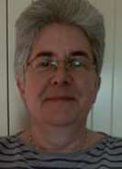
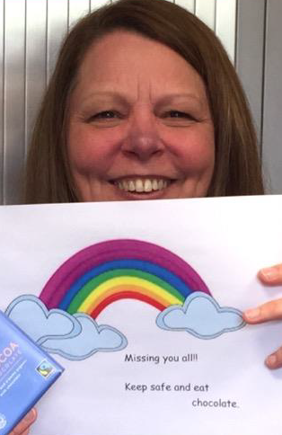
THANK YOU REALITY CHURCH
It was lovely enjoying a collective worship filmed by our friends at Reality Church this week.
Sandie, Esther and Eddie had created a short film with stories, a magic trick and a prayer that was on the theme of ‘Being Connected’.
We really appreciate the thought, time and effort that Barry and Ria and the Team from Reality Church put into these online assemblies.
I know that they are keeping the St Andrew’s family in their thoughts and prayers at the moment.
Thank you so much to David Evans from ‘Essex PC Helps’ for his kind donation of 3 refurbished laptops.
We really appreciate this kind gesture.
STAFF CHANGES AFOOT
We are really pleased to be welcoming back Mrs Bourne
to St Andrew’s after the birth of her third baby in June.
She is going to be re-joining the Year Three team and will be working on a Monday and Tuesday in Apple base (after lockdown).
This of course means that we are saying Goodbye to Mrs Reynolds who has been teaching in Year Three since September.
We shall all miss her greatly and are hoping that we will see her again in school very soon.
Mrs Draper (our School Business Manager)
will also be leaving us in March.
We will miss her very much and wish her well in her new role as Finance Officer in a Secondary School.

Slide 3
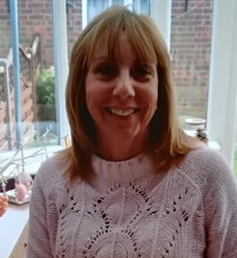
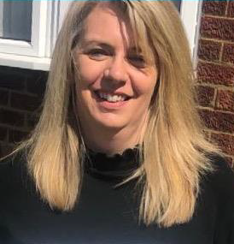
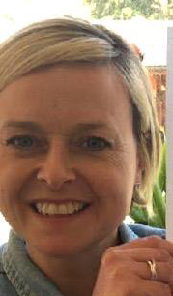
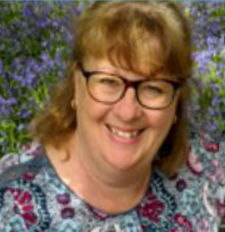
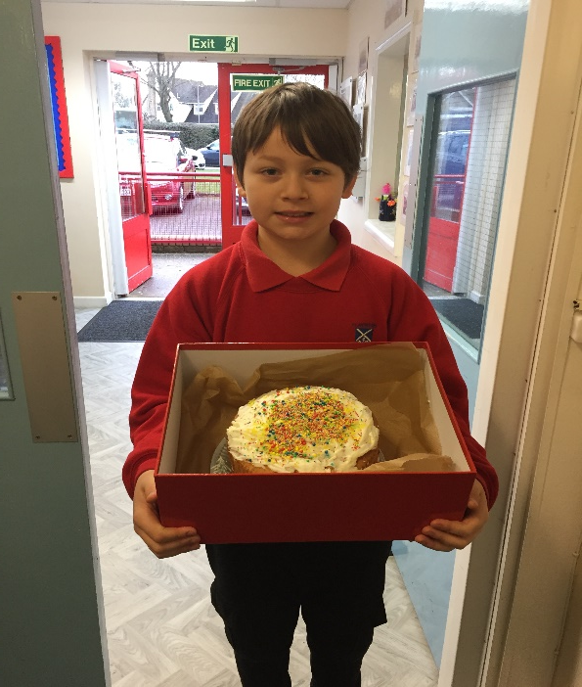
Care-calls home
This week, some of you may have had a phone call home from a member of staff in school.
These are an opportunity to asks any questions or to say how things are with you and your child.
I thought it would be useful for you and your child to be able to put a face to the names of staff members calling.
So I would like to introduce:
Mrs Baker Miss Brennand Mrs Walton Mrs Claydon
It is lovely hearing your news and about how things are going at home. All of your feedback is really valued as we are keen to support all of our families as much as we can.
Delicious Cake delivery from Harry G!
The staff have been very lucky to have had a number of delicious deliveries from Harry this term!
Today’s was amazing! Thank you for taking so much time to make and decorate such a lovely cake!

Slide 4


Slide 5
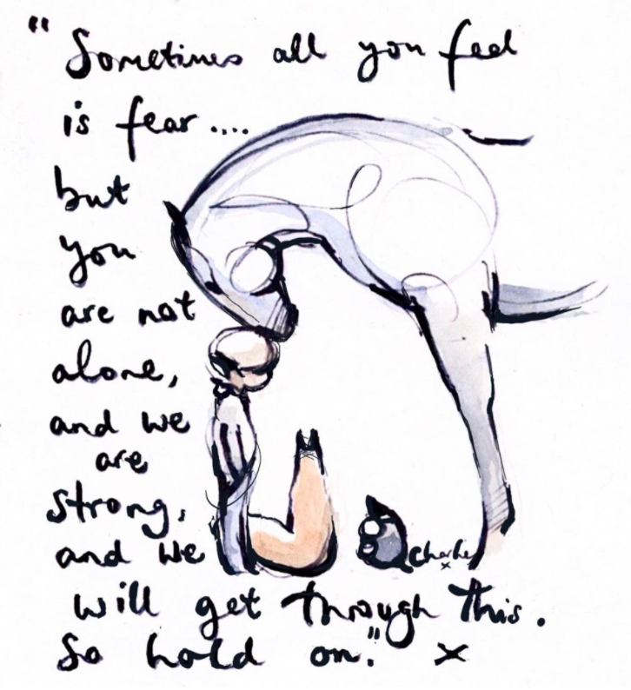
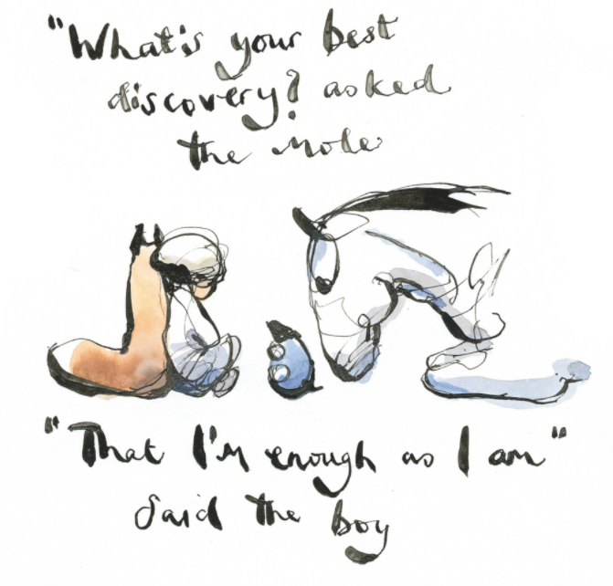
These are the children who have been spotted shining this week.
Whether as part of our school-learning or online in their home-learning.
Well done for continuing to demonstrate our CARE values during these challenging times.
Alexander M
Zack M
Lottie A
Emily L
Izzy W
Freddie C
Busola A
Lilly D
Compassion Achievement Respect Enjoyment
Every child is known and loved.
Every child shines.
Follow Charlie Mackesy on Twitter
@charliemackesy

