Slide 1




Dear Parents and Carers,
So … we have made it to the end of Week 3! Well done one and all.
We are so very impressed with the effort and enthusiasm that so many of the children are putting into their learning both at home and in school.
The government have been true to their word… and we received lateral flow tests today for all school staff to use. The purpose of the testing is to identify any members of staff who may have COVID 19 but be asymptomatic.
Should a member of staff test positive I will inform any year group bubbles as quickly as possible- it will of course mean that the bubble will need to self-isolate; but I will share guidance if and when it is an issue.
It is a relief to know that we have these tests and that we are not inadvertently infecting any children, colleagues or our families at home.
Our daily Collective worship at 1:30 has fast become my favourite time of day; seeing so many smiling faces and some lovely engagement feels so important in keeping our ‘St Andrew’s Family’ together at this difficult time.
Thank you for your patience as I navigate a number of technical issues very publically! The frustration of a camera that has worked for three hours of Teams meetings but then won’t work for Google Meet is enormous!
Wishing you all well, and hoping that this weekend is as fun-filled as you can manage!
Please do take care with my very best wishes
Becky Black
Hatfield Peverel St Andrew’s Junior School
NEWSLETTER
22nd January 2021
Wishing a very Happy Birthday to the children who have celebrated their birthdays between:
January 18th and January 24th
Thomas, Antonia, Keira F,
Mrs Reynolds
Apologies to Year 5 and 6 for muddling up the post Collective worship chats this week- next week we will catch up! Whoops!

Slide 2
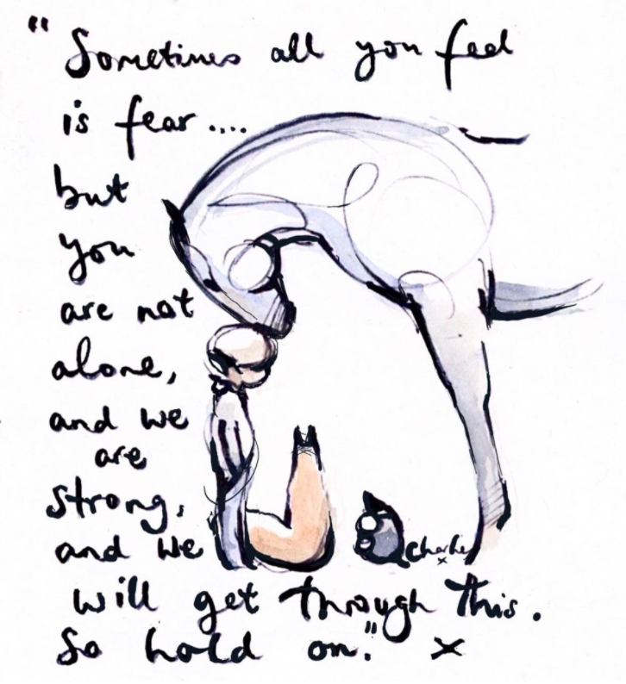
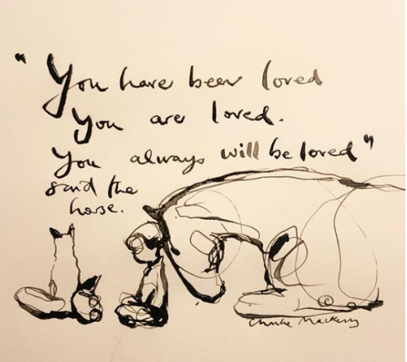
These are the children who have been spotted shining this week.
Whether as part of our school-learning or online in their home-learning.
Well done for continuing to demonstrate our CARE values during these challenging times.
Logan E
Eli G
Harry L
Tia G
Joshua T
Chloe W
Oliver C
Ben W
Compassion Achievement Respect Enjoyment
Every child is known and loved.
Every child shines.
Hard to beat a Charlie Mackesy image
at the moment!

Slide 3


