Slide 1




Dear Parents and Carers,
Another week in our strange new world!
I do hope that you are all managing ok with the many changes and challenges you are facing.
It has been wonderful to see the brilliant engagement in Google Classroom, the way that so many children are managing to adapt to home learning is a testament to the support, help and hard-work that you, as parents, are providing.
Thank you so much.
Please know that there may be days when ‘the wheels fall off’; where it seems a huge ask and when technology, moods or ‘life’ are just not helping- please be kind to yourselves- there is always a new day!
If I am honest, being the mother of teenagers has never been quite so easy; independent and able to ‘just get on’.
For Primary aged children home-schooling will not be quite so straight forward for you- I know.
We are cheering you all on- we will get there!
Please remember, if you have any concerns do reach out as we will help as much as we can.
I can see the challenges faced by so many of you- please know what a good job you are doing!
Wishing you all well, and hoping for moments of brightness for you all please do take care
Becky Black
Hatfield Peverel St Andrew’s Junior School
NEWSLETTER
15th January 2021
Wishing a very Happy Birthday to the children who have celebrated their birthdays between:
January 11th and January 17th
Tyler, Elijah F, Jessica L,
Stanley B,

Slide 2
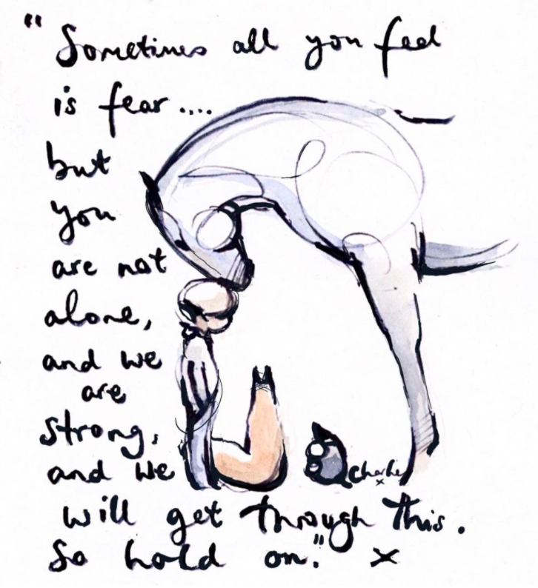
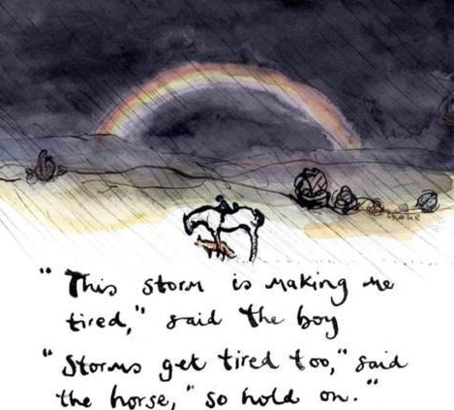
These are the children who have been spotted shining this week.
Whether as part of our school-learning or online in their home-learning.
Well done for continuing to demonstrate our CARE values during these challenging times.
Dylan A
Harry I
Brooke S
Tom P
Freya S
Kingsley M
Rebecca T
Hassan F
Compassion Achievement Respect Enjoyment
Every child is known and loved.
Every child shines.
Hard to beat a Charlie Mackesy image
at the moment!

Slide 3


