Slide 1




Dear Parents and Carers,
What a start to the New Year! I do hope that your Christmas break had moments of fun, calm, laughter and magic. It was certainly a quiet Christmas for most of us - but I hope one that brought you all some moments to treasure even though they were unlikely to be filled with everyone you wanted to see.
So 2021 has brought to us Lockdown 3.0 and the return of home-learning.
Although as a school we have had our remote-learning offer available since October 2020 the need for the vast majority of our children to access this at short notice was a huge logistical task indeed.
I would like to express my sincere thanks to Mrs Dutaut and all of the teachers who have worked incredibly hard to quickly refresh themselves with the workings of Google Classroom, who have had to adapt all lessons and then record themselves to share with the children. Please do not underestimate the stress that recording films causes - none of them are actors or used to delivering to such a wide audience!
Thank you to those of you who have sent kind messages or emails expressing your positive thoughts – it has heartened everyone!
The recording are a warts and all version - I am asking teachers not to re-record if they stumble over a word or become tongue-tied– we are all human!!
Thank you for your ongoing support we really appreciate it and do understand that you are, again, in a difficult position.
I hope that you are all managing to balance everything at home; if you have any questions or concerns please do make contact. We are working really hard to support all of our families at home and those whose children are attending school-learning.
Wishing you all well, and hoping for moments of brightness for you all please do take care
Becky Black
Hatfield Peverel St Andrew’s Junior School
NEWSLETTER
8th January 2021
Wishing a very Happy Birthday to the children who have celebrated their birthdays between:
January 6th and January 10th
Alexander D, Benjamin R,
Mrs Boyce

Slide 2
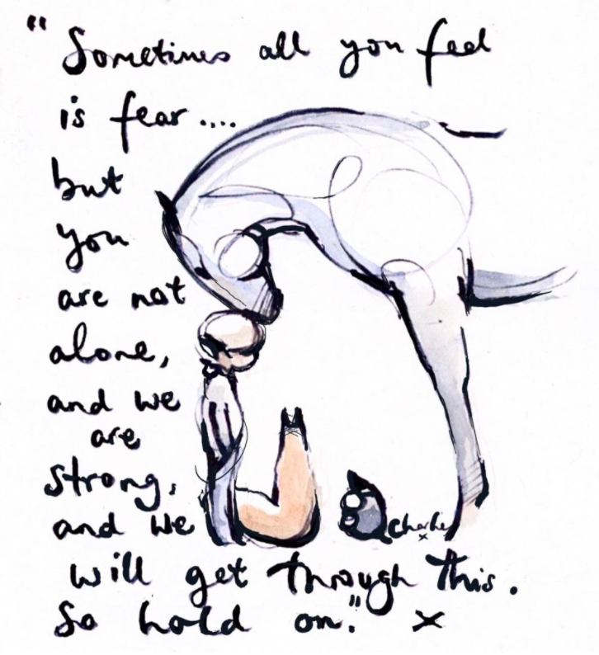
These are the children who have been spotted shining this week.
Whether as part of our school-learning or online in their home-learning.
Well done for continuing to demonstrate our CARE values during these challenging times.
Abigail J
Jessica L
Clark W
Tia G
Evelyn C
Fearne C
Amelia B
Keira F
Compassion Achievement Respect Enjoyment
Every child is known and loved.
Every child shines.
Thank you so much to: Paul Mason Associates for the kind donation of IT equipment. Mrs M. Elliston for the donation of a kindle. Mrs H. Oatway for the donation of a large number of very high quality books. We really appreciate these kind offers and your support to our school.
Hard to beat a Charlie Mackesy image
at the moment!

