Slide 1




Dear Parents and Carers,
As we approach the finishing line of lockdown 3.0's 'Home learning Challenge' - I am absolutely positive that the last 2 months have been incredibly tricky in so many different ways for so many of you. The resilience and strength that you and your children have displayed has been amazing. We really know it hasn't been easy.
Next week sees a change to our current lesson format. Tuesday is 'Maths Day' and Thursday is 'World Book Day'. These days have been designed to allow the children (in school and at home) to work independently with reduced screen access and greater choice and creativity; allowing teachers to meet online with you to discuss your child's return to school on March 8th.
Friday 5th March will also have more creative tasks planned; allowing teachers in school to prepare the building for the whole school return on Monday.
Next week I will share the specifics of the school return- but as I said earlier this week they will not be very different from September!
Wishing you all well- hopefully we will have another sunny weekend to enjoy.
Please do take care with my very best wishes
Becky Black
Hatfield Peverel St Andrew’s Junior School
NEWSLETTER
26th February 2021
Wishing a very Happy Birthday to those who have celebrated their birthdays between:
February 22nd and February 28th
Harry S, Mrs Spilling

Slide 2

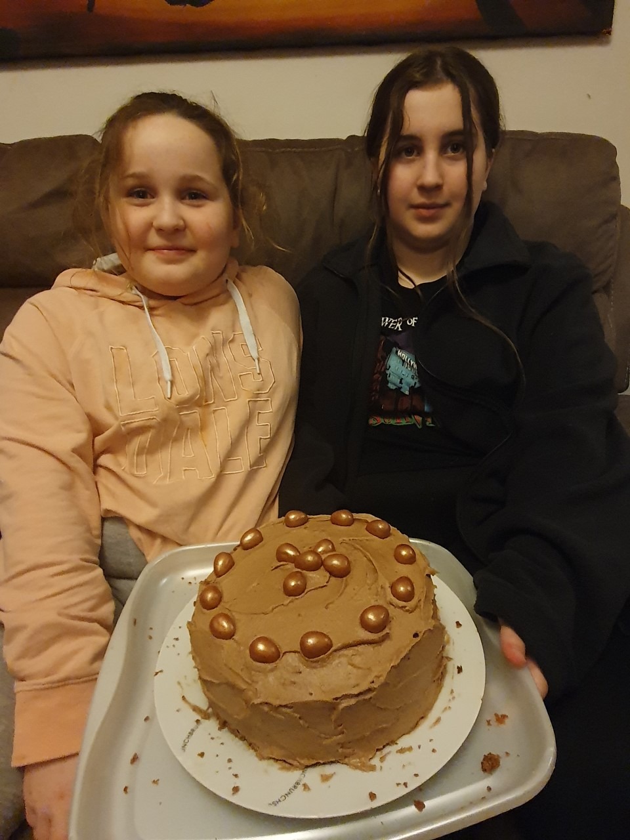

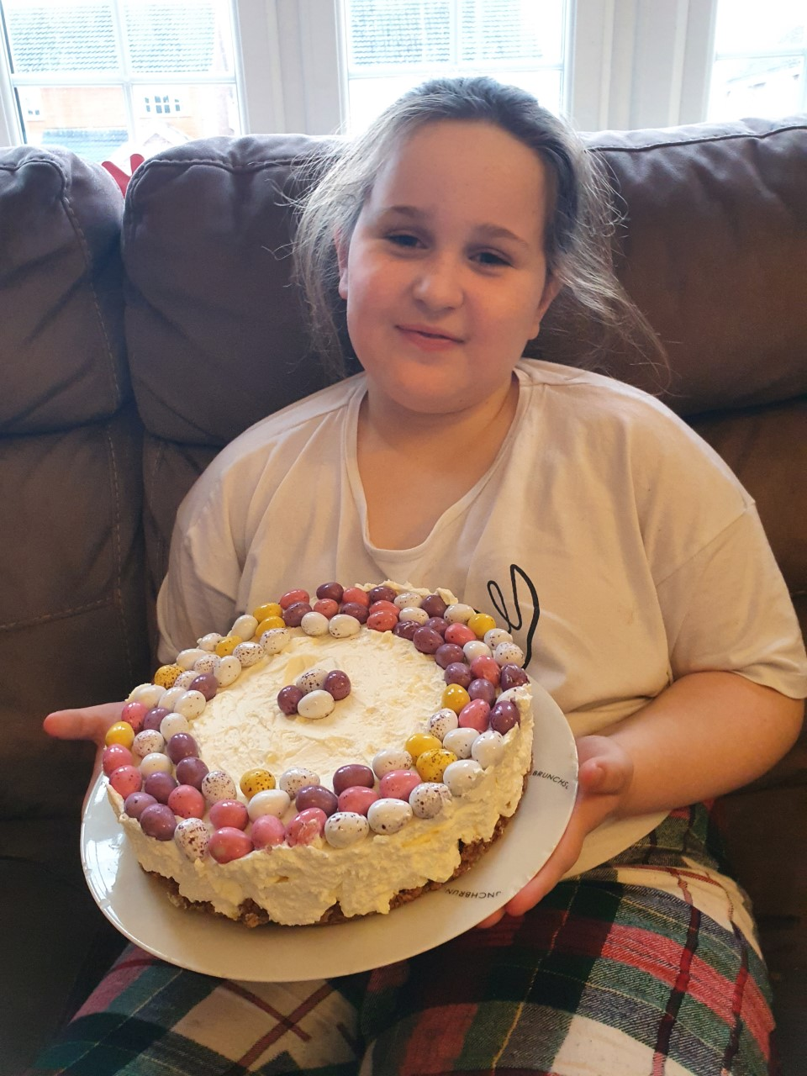
What did you do over the half term holiday to shine in your own way?
Olivia and Amelia raised money by baking cakes – they look delicious!
If you haven’t had a chance to submit your fundraising money yet, the link is still open;
https://www.gofundme.com/sponsored-shine
We would also love to see photos of your efforts!
Parent’s Consultations
On Tuesday 2nd March and Thursday 4th March we will be holding consultation appointments.
The appointments will take place using Google Meet, through your child’s Google Classroom. The meet link will be available at the top of your child’s base page (not year group), please click the link when your appointment is due to start, and click ‘Ask to join’. You will be admitted by the class teacher.
The links to book your appointments are now live;
Apple Base; https://forms.gle/JJJ5LdLLTZB44GWn7
Birch Base; https://forms.gle/Vf2uftobxBHkd5Ht8
Cherry Base; https://forms.gle/Jh6q2LxUWoyx4JLi6
Fir Base; https://forms.gle/3KRNGEjWRJeMydmU8
Maple Base; https://forms.gle/f8HvK1xibC4G9os87
Oak Base; https://forms.gle/KeveRUpqDqhd9CD58
Rowan Base; https://forms.gle/cYjUcwzWZQTvVXiCA
Sycamore Base; https://forms.gle/LSap4aHrTLGhxBEa8
One Plan Reviews with Mrs Dutaut; https://forms.gle/7n93hLUi6GdJb7vKA

Slide 3



Are you concerned about child's safety on the internet and would like advice and support on how to keep them safe?
The Essex Child and Family Wellbeing Service presents
Virtual eSafety Parent Workshops with
Wednesday 17th March 2021
8.00pm – 9.30pm
These free parent’s workshops will look at the online world and how our young people are using it. How they are navigating around restrictions and using the internet without the parent’s knowledge.
This includes :
Favourite apps and games.
Dangers they face
How young people are being influenced online
Solutions that parents can adopt to help keep their children safe.
Stranger Danger message that parents are familiar with and make it ready for 2021
To book your place now please call us on 0300 247 0014
Monday – Friday 9am-5pm

Slide 4
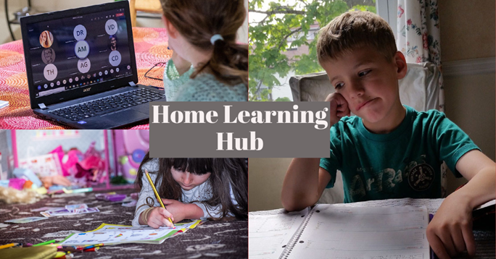

ACL Home Learning Hub
This is an area with a wealth of resources to support you and your children with all things home learning through the stages.
In order to access the Home Learning Hub sign up for one of the FREE 1 hour long sessions:
Wed 10th March 2pm - workshop will look at how pictures tell a story encouraging your KS1 child to express their ideas with pictures!
Book now: https://tinyurl.com/Home-Learning-KS1-Storytelling
Thurs 11th March 3pm - exploring how your KS2 child could write their own Horrible History Comic Strip or graphic novel
Book now: https://tinyurl.com/Home-Learning-KS2-Comic-Strips
Wed 17th March 2pm - workshop will explore how storyboarding can be used to extend writing.
Book now: https://tinyurl.com/Home-Learning-KS3-Storyboards
More sessions being added weekly.
If people require additional support then do check out our current Newsletter and Half Term ideas

Slide 5
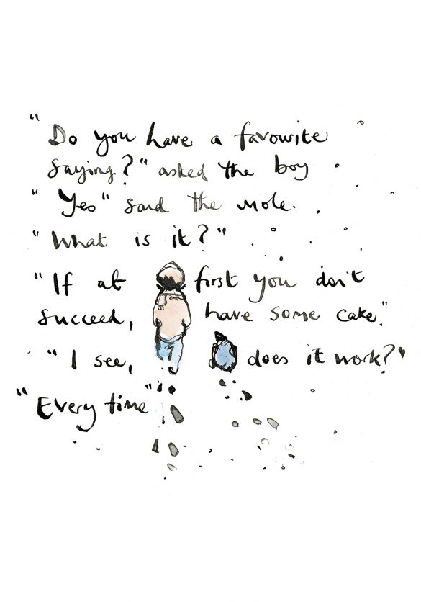
These are the children who have been spotted shining this week.
Whether as part of our school-learning or online in their home-learning.
Well done for continuing to demonstrate our CARE values during these challenging times.
Jean-Manuel– Apple
Riley R– Birch
Alice R – Cherry
Ethan P– Fir
Thomas F– Maple
Isobelle S- Oak
Lewis A – Rowan
Alf S– Sycamore
Compassion Achievement Respect Enjoyment
Every child is known and loved.
Every child shines.
Follow Charlie Mackesy on Twitter
@charliemackesy

